Slide 1
Chapter 8
How to test, debug, and deploy a program

Slide 2
Objectives (part 1)
Applied
Develop a test plan for a C++ program and then test it using that plan.
Use the cout object to trace the execution of a C++ program.
Use Visual Studio or Xcode to debug a program by setting breakpoints, stepping through code, inspecting variables, and inspecting the stack trace.
Deploy your C++ programs and then run them using one of the techniques presented in this chapter.
Knowledge
Distinguish between testing and debugging.
Distinguish among syntax, compile-time, runtime, and logic errors.

Slide 3
Objectives (part 2)
Describe the process of using the cout object to trace the execution of a program.
Describe the use of breakpoints and stepping through code when you’re using an IDE like Visual Studio or Xcode for debugging.

Slide 4
The Future Value program with a logic error
The Future Value Calculator
INPUT
Monthly Investment: 100
Yearly Interest Rate: 3
Years: 3
OUTPUT
Monthly Investment: 100.00
Yearly Interest Rate: 3.0
Years: 3
Future Value: 3662.06
Continue? (y/n):

Slide 5
The goal of testing
To find all errors (bugs) before the program is put into production.
Three test phases
Check the user interface to make sure that it works correctly.
Test the program with valid input data to make sure the results are correct.
Test the program with invalid data or unexpected user actions. Try everything you can think of to make the program fail.

Slide 6
The goal of debugging
To fix all errors (bugs) before the program is put into production.
The three types of errors that can occur
Compile-time errors are caught by the IDE or compiler before you run the program. These errors are usually syntax errors that violate the rules for how statements must be written.
Runtime errors don’t violate the syntax rules, but they can cause the program to crash or to yield unexpected results.
Logic errors are statements that don’t cause syntax or runtime errors, but produce the wrong results.

Slide 7
Code that contains syntax errors
double get_double(string prompt) {
num; // no data type declared
while (true) {
cout << prompt // missing semicolon at end of statement
cin >> num;
if (cin.fail() { // missing closing parenthesis
cout << "Error! Invalid number. Try again.\n";
cin.Clear(); // improper capitalization
cin.ignore(1000, '\n');
continue;
}
cin.ignore(1000, '\n');
return num;
}
}

Slide 8
Common syntax errors
Misspelling keywords.
Forgetting to declare a data type for a variable.
Forgetting an opening or closing parenthesis, bracket, or brace.
Forgetting an opening or closing quotation mark.
Forgetting to code a semicolon at the end of a statement.

Slide 9
Problems with identifiers
Misspelling or incorrectly capitalizing an identifier.
Name collisions due to attempting to use a keyword, global constant, or global function as an identifier.
Problems with values
Not checking that a value is the right data type before processing it. For example, you expect a number to be entered, but the user enters a non-numeric value instead.
Using one equals sign (=) instead of two (==) when testing values for equality.

Slide 10
A problem with floating-point numbers
Using floating-point numbers that can lead to arithmetic errors. For example:
double d = 0.2 + 0.7 // d = 0.8999999999999999
cout << d << endl; // displays 0.9 because of cout's
// default rounding
if (d == .9) // this is not true!
You can prevent errors like this by rounding or by not using the equality operator as described in chapter 6.

Slide 11
The MPG program tested with valid data
Miles Per Gallon Calculator
Enter miles driven: 325
Enter gallons of gas used: 10
Miles per gallon: 32.5
The MPG program tested with invalid data
Miles Per Gallon Calculator
Enter miles driven: ten
Enter gallons of gas used: Miles per gallon: 1

Slide 12
Starting to test the Future Value program with invalid data
The Future Value Calculator
INPUT
Monthly Investment: ten
Error! Invalid number. Try again.
Monthly Investment: 0
Error! Number must be greater than 0. Try again.
Monthly Investment: 10000
Error! Number must be less than 10000. Try again.
Monthly Investment: 9999
Yearly Interest Rate:

Slide 13
The two critical test phases
Test the program with valid input data to make sure the results are correct.
Test the program with invalid data or unexpected user actions. Try everything you can think of to make the program fail.
How to make a test plan for the critical phases
List the valid entries that you’re going to make and the correct results for each set of entries. Then, make sure that the results are correct when you test with these entries.
List the invalid entries that you’re going to make. These should include entries that test the limits of the allowable values.

Slide 14
Two common testing problems
Not testing a wide enough range of entries.
Not knowing what the results of each set of entries should be and assuming that the answers are correct because they look correct.

Slide 15
How to trace execution by displaying messages
double calculate_future_value(double monthly_investment,
double yearly_interest_rate, int years) {
cout << "calculate_future_value() starting...\n";
// convert yearly values to monthly values
double monthly_rate = yearly_interest_rate / 12 / 100;
int months = years * 12;
// calculate future value
double future_value = 0;
cout << "monthly_investment: " << monthly_investment << endl;
cout << "monthly_rate: " << monthly_rate << endl;
cout << "months: " << months << endl;
for (int i = 1; i < months; ++i) {
future_value = (future_value + monthly_investment) *
(1 + monthly_rate);
cout << "month " << i
<< " future_value: " << future_value << endl;
}
return future_value;
}

Slide 16
The data that’s displayed on the console (part 1)
The Future Value Calculator
INPUT
Monthly Investment: 100
Yearly Interest Rate: 3
Years: 3
calculate_future_value() starting...
monthly_investment: 100
monthly_rate: 0.0025
months: 36
month 1 future_value: 100.25
month 2 future_value: 200.751
month 3 future_value: 301.503
month 4 future_value: 402.506
month 5 future_value: 503.763
...
month 35 future_value: 3662.06

Slide 17
The data that’s displayed on the console (part 2)
OUTPUT
Monthly Investment: 100.00
Yearly Interest Rate: 3.0
Years: 3
Future Value: 3662.06

Slide 18
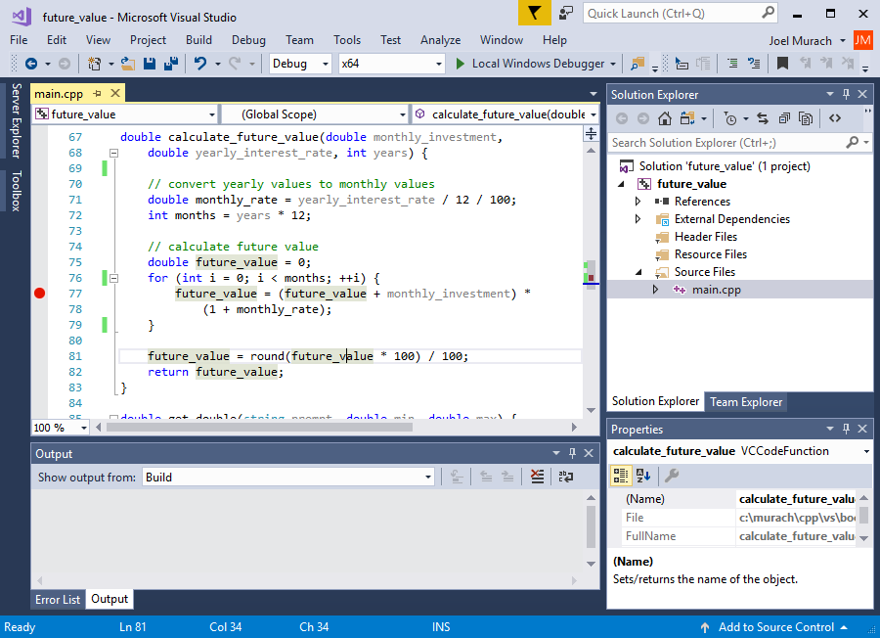
Visual Studio with a breakpoint

Slide 19
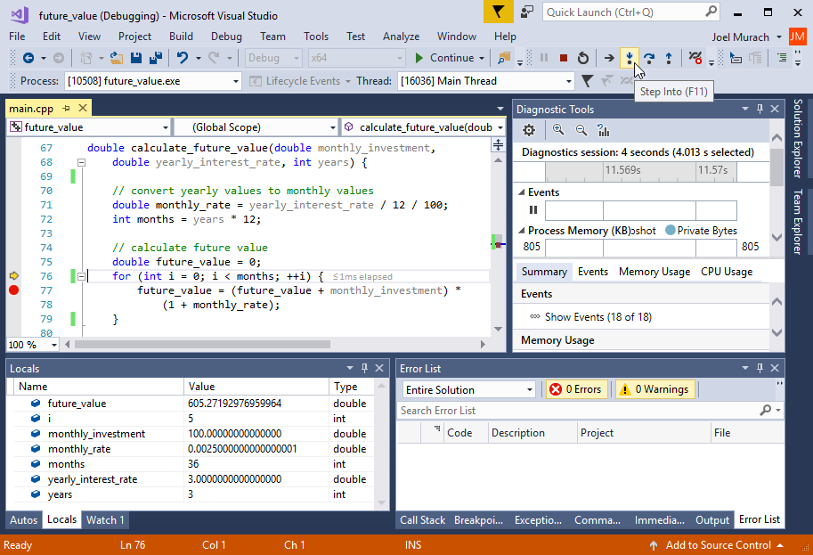
A debugging session with Visual Studio

Slide 20
Some of the buttons on the VS Debug toolbar
Button Keyboard shortcut
Step Over F10
Step Into F11
Step Out Shift+F11
Continue F5
Stop Debugging Shift+F5

Slide 21
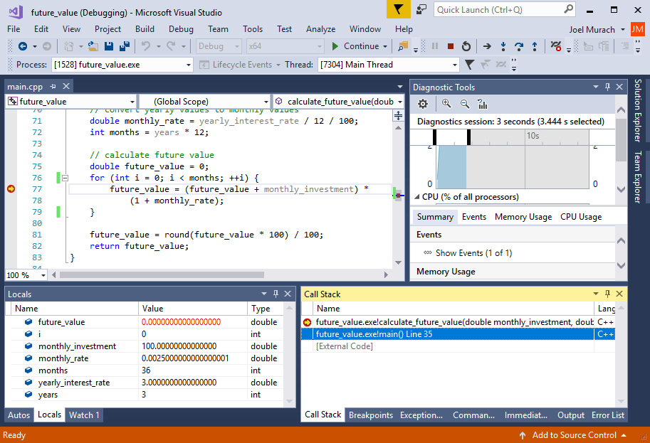
The Visual Studio Call Stack window

Slide 22
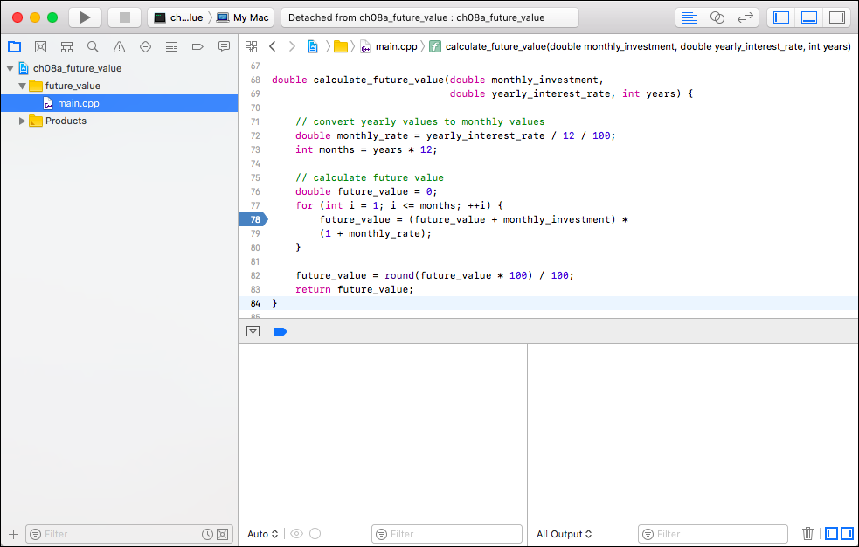
Xcode with a breakpoint

Slide 23
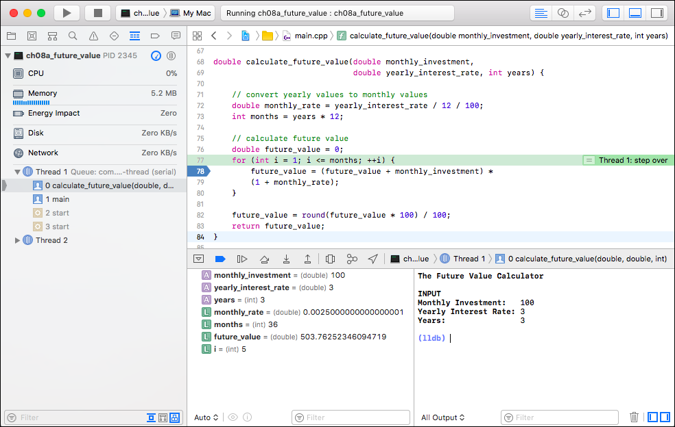
A debugging session with Xcode

Slide 24
Some of the buttons on the Xcode Debug toolbar
Button Keyboard shortcut
Step Over F6
Step Into F7
Step Out F8
Continue Cmd+Ctrl+Y

Slide 25
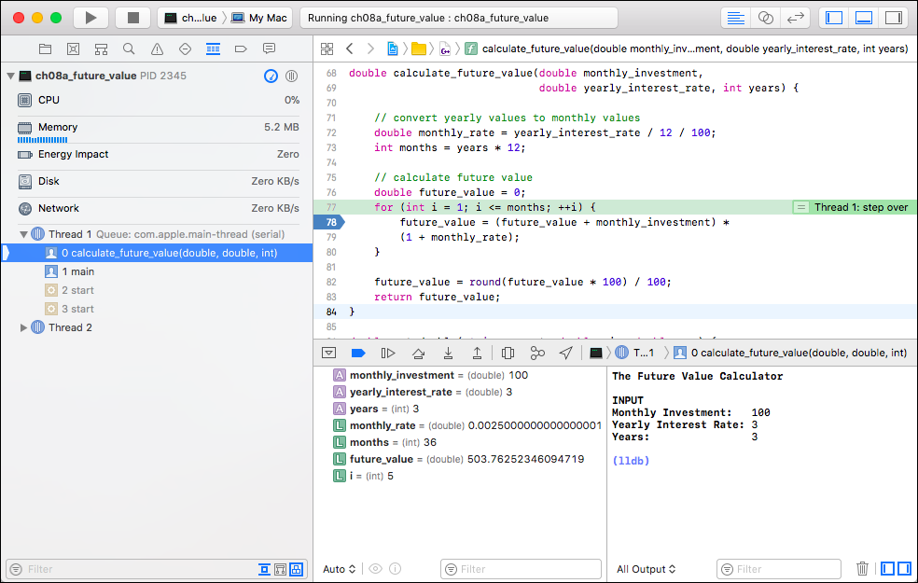
The Xcode Call Stack window

Slide 26
Typical folder and filename of the executable file
For Visual Studio
C:\murach\cpp\vs\book_apps\ch08a_future_value\x64\Debug\ future_value.exe
For Xcode
/Users/Username/Library/Developer/Xcode/DerivedData/ ch08a_future_value/Build/Products/Debug/ch08a_future_value

Slide 27
How to deploy an executable file
Once you’ve created and found the executable file for a program, you can deploy it by making the executable file available to your users.
Two ways to run the executable file
Use Explorer (Windows) or Finder (Mac) to locate the executable file. Then, double click on it.
Start a Command Prompt (Windows) or Terminal (Mac), use the cd command to change to the folder that contains the executable file, and enter the name of the executable file.
Code that you can add to keep the console open
cin.ignore(1000, '\n'); // discard all extra data
cout << "Press [Enter] to exit...\n";
cin.ignore();

Slide 28
How to use the console to run an executable file
On Windows
cd \murach\cpp\dist
future_value
On macOS or Linux
cd \Documents/murach/cpp/dist
./future_value

